Slide 1


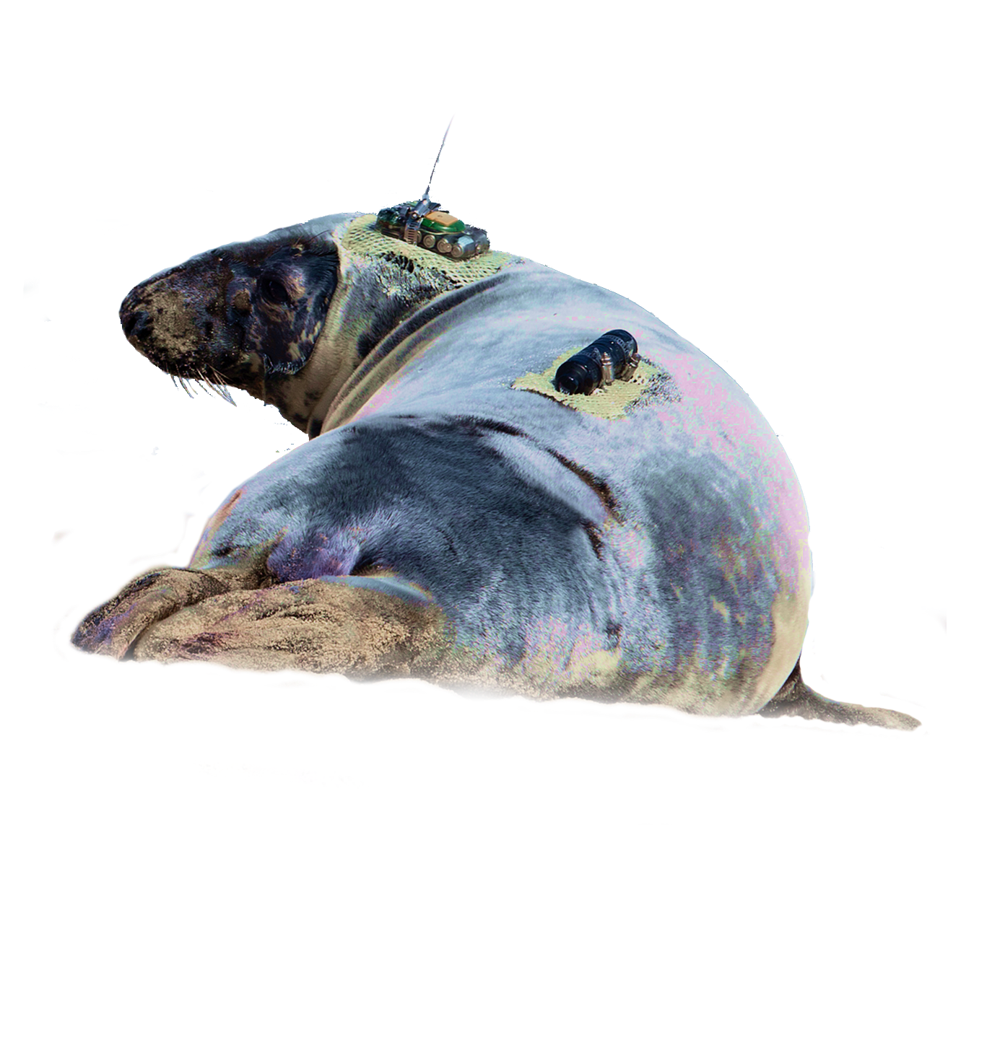
who we are
Started 2008 w/ funding from CFI / NSERC ); inherited POST datasets; HQ in Halifax, NS
Collaborative, globally-linked infrastructure platform and research network
Measuring marine animal movements & survival
1800+ OTN acoustic receivers + 20,000 independent, compatible receivers deployed globally
OBIS ENV Workshop
April 2018
Photo: D. Lidgard
Notes:
Hi, I’m Jon Pye from the Ocean Tracking Network. We’re a global aquatic animal tracking, data management, and partnership platform headquartered at Dalhousie University in Canada. OTN began in 2008 with a mission to support telemetry research across Canada’s three coasts and to build strong international partnerships across all of the world’s oceans. Our headquarters and data center began in support of a two-prong, seven-year scientific programme, a Canadian component that supported the study of keystone species in the Pacific, Arctic, and Atlantic regions with thousands of listening stations and tens of thousands of tags. And a global facet of the Ocean Tracking Network, partnerships built in South Africa, Australia, the USA, and Europe, and in fact some of the key contributors to OTN’s international scientific and data management steering committees are sitting here in the room.
OTN’s data work focuses primarily on acoustic telemetry because of the high immediate value of acoustic data collaboration, though we do some satellite work as well, especially in support of mobile receiver platforms like autonomous underwater vehicles, ocean gliders and animal oceanographers like this fella here.

Slide 2
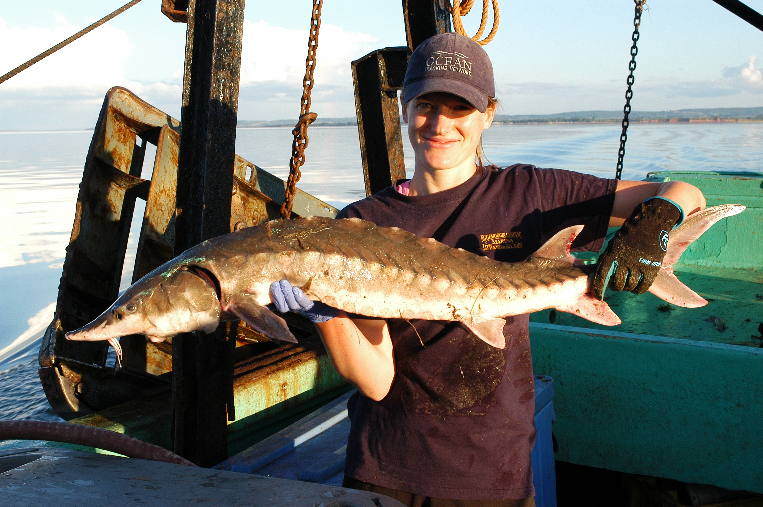
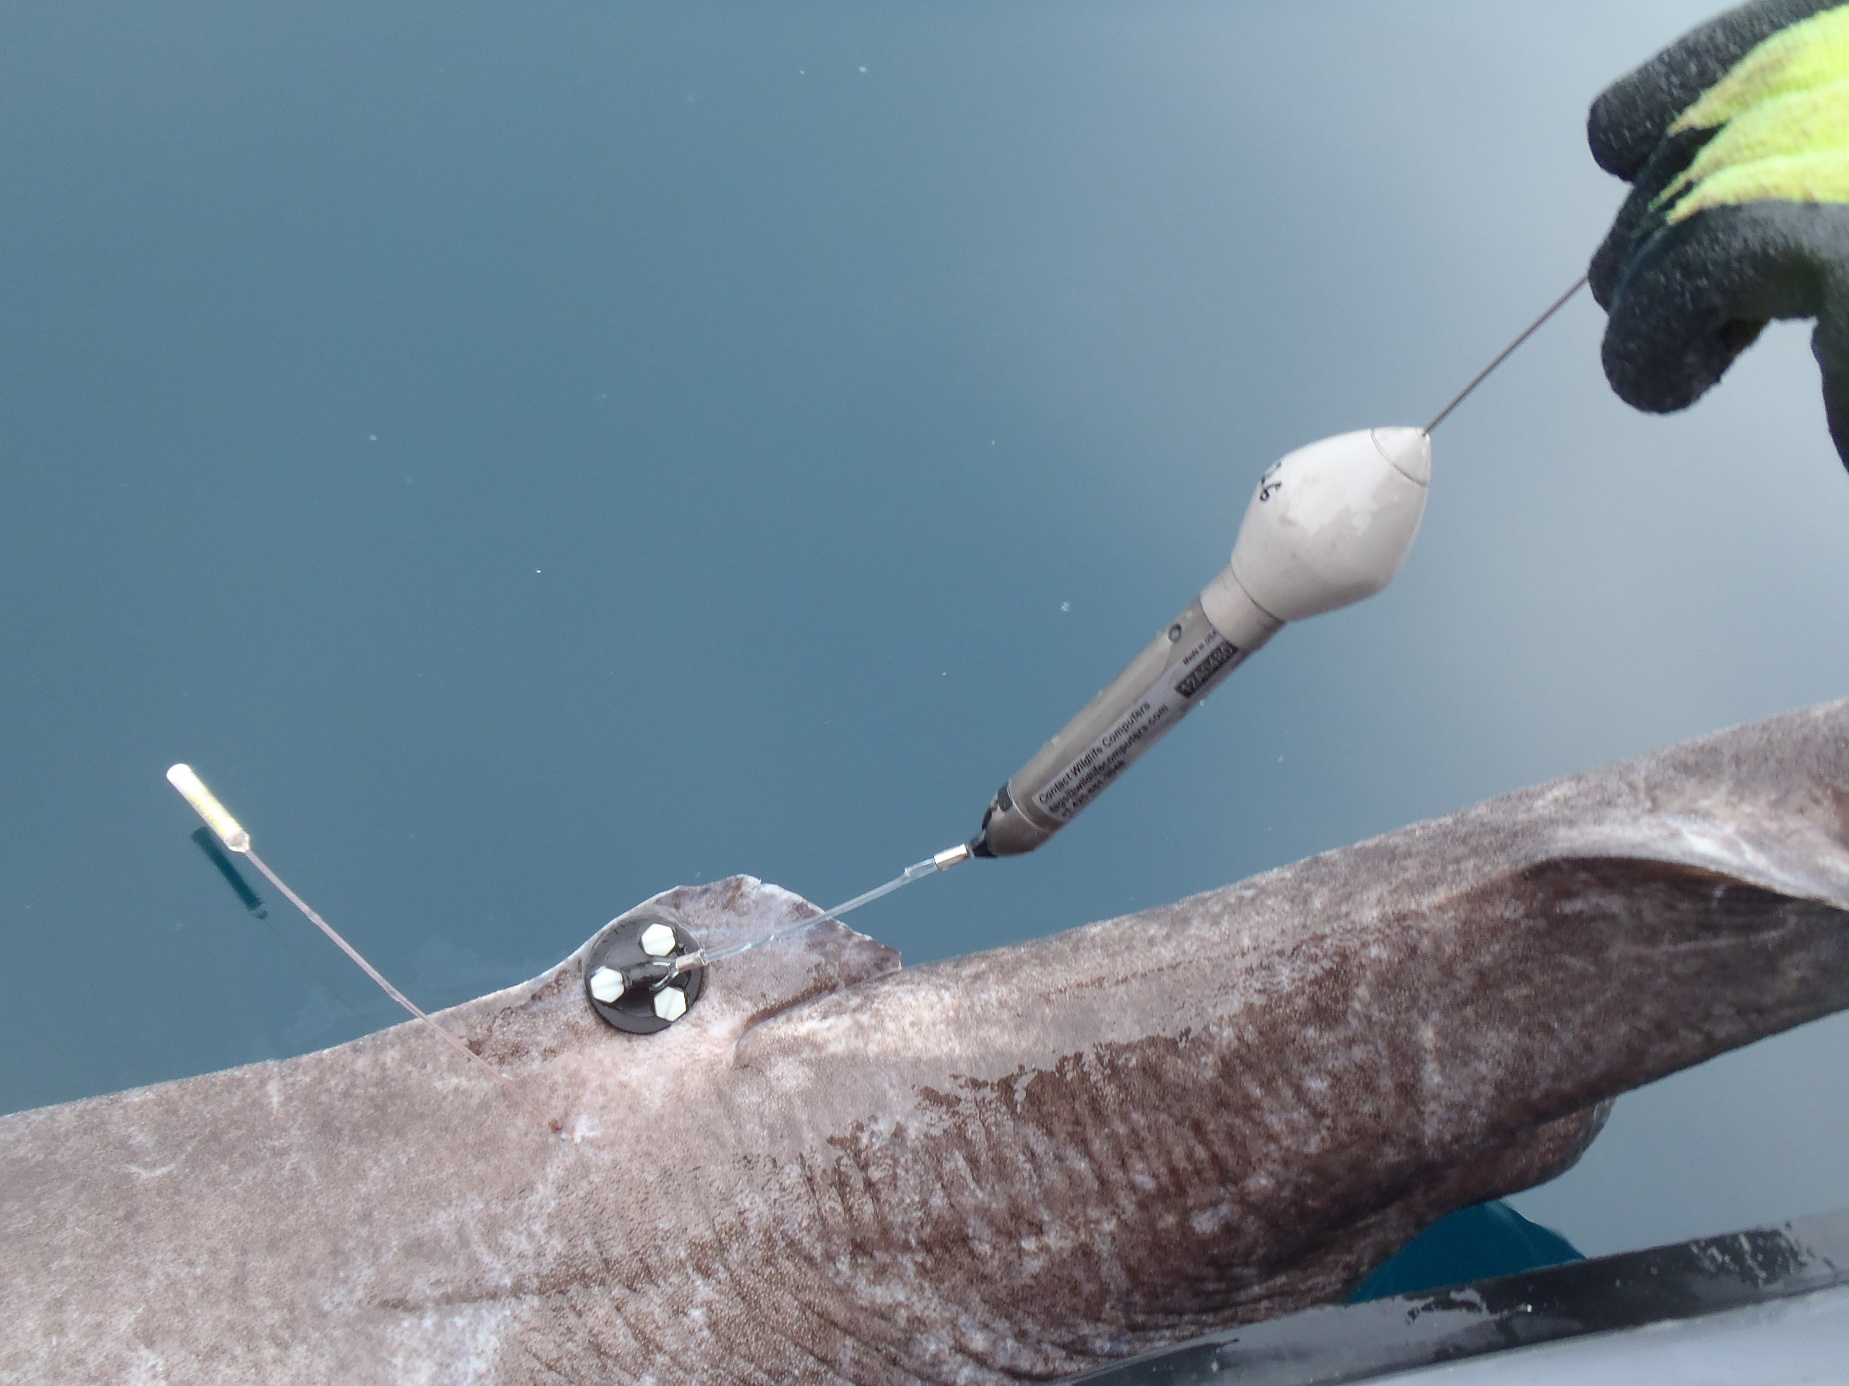
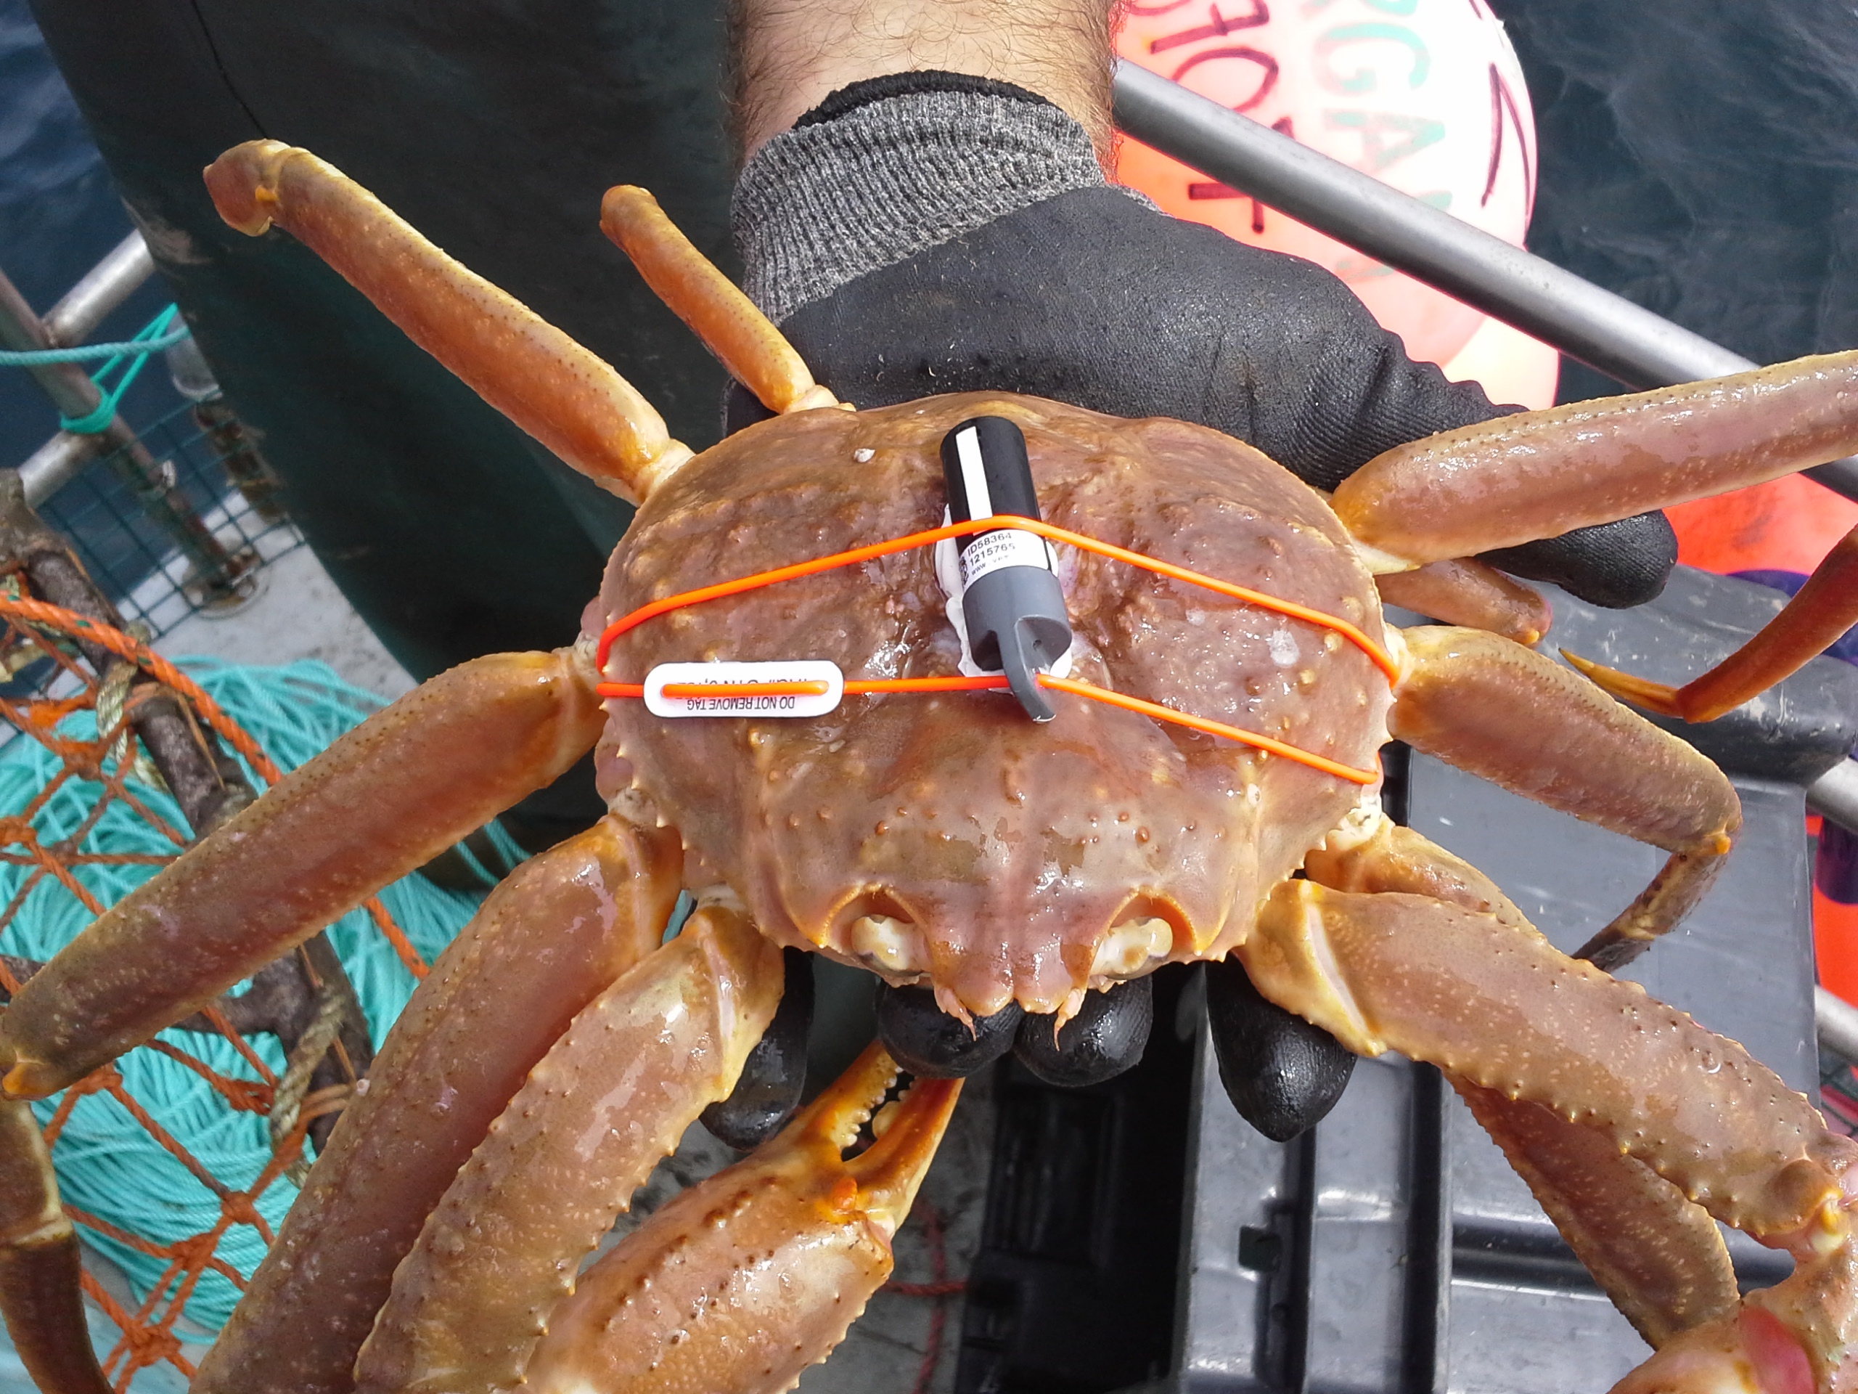
what we do
Using electronic tags to track over 150 keystone, commercially important, & endangered species
Globally-shared data warehouse, 6 staff contributors to shared telemetry QC, analysis & visualization tools
Novel Developments:
Bioprobes: large marine animals equipped to track other tagged animals
Roboprobes: ocean-going, remote monitoring gliders / mobile receivers
Evidence-based
decision making
Training the next
generation;
engaging leading
Canadian scientists
Assisting government;
increasing research capacity
Notes:
OTN-affiliated researchers use the latest technologies in animal acoustic and satellite telemetry to track over 150 different species. This information is aggregated into the global OTN data warehouse, where we cross-reference, quality control, and reformat the data for the researcher’s optimal use with data analysis and visualization tools. OTN-affiliated researchers have designed tracking studies in many interesting ways; creating mobile animal-borne listening stations that carry receivers instead of tags to capture interspecies interaction, or adding standard oceanographic instrumentation to the animal payload for reporting animal behavior or ocean conditions in near-real time. OTN also maintains a fleet of AUVs and ocean gliders that carry their own oceanographic payloads to assist in characterizing the habitat around our listening stations. Some of these vehicles can also can recover and offload data from those underwater listening stations, all while acting as mobile detectors themselves.
These adjacent-to-tracking efforts help our researchers to guarantee access to timely, relevant evidence to assist in decision making, as with the right whale monitoring program currently underway in the Gulf of St Lawrence and on the Scotian Shelf, as well as the glider-mounted hydrophones we are piloting in the Salish Sea to identify and report whales based on their calls. We have built and we are continuing to build on this capacity to perform responsive remote sensing and providing a new capacity for spatial ecologists and biologists to use these tools in the design of studies that can provide timely answers to management challenges.

Slide 3
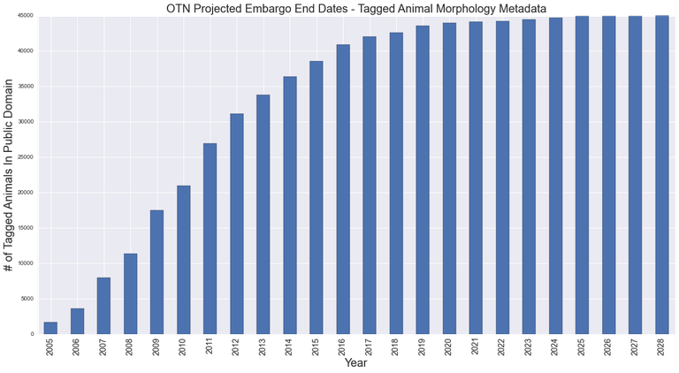
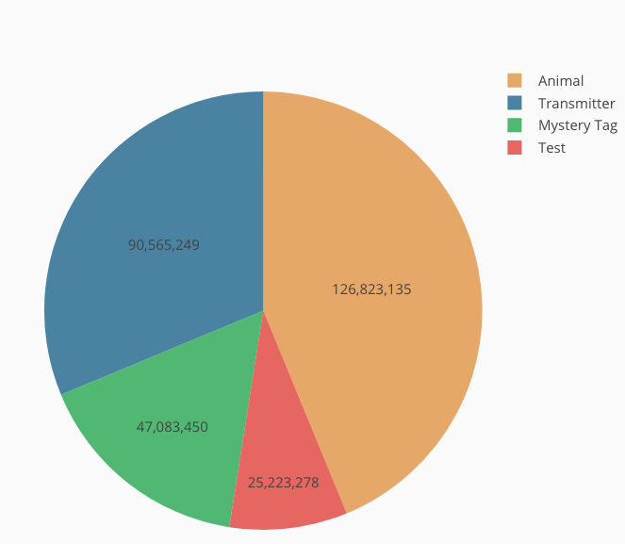
OTN by the numbers
OTN vets telemetry project data on receipt, reports to OBIS when embargo period expires
2017 - focus was to chase down holders of data for reporting -> +50m detections
2018 - the year we get data to go public. Focus on informing researchers embargo period end and confirming final state of datasets.
19000+ OBIS-ready individuals / > 45000 tagged animals cleared to go to OBIS
Only release data reported at first - 1 observation per animal
35m detections by OBIS-ready projects / 121m total detections of animals in the OTN db.
Compressed into ~800,000 MachineObservation Occurrence records, binned by time/loc.
Notes:
Our long-standing relationship with OBIS stems from our common ancestry in the Census of Marine Life in 2000, and data cleared for publication by OTN’s Data Policy will be expressed to OBIS via the appropriate IPT for that project. We’ve put some recent effort into completely automating this process, and some –very- recent effort into automating the reporting using the OBIS-ENV format.
OTN is now testing a format that will allow us to report millions of instances of machine-observed animal presence from 2000 to 2018, derived from groupings of acoustic and satellite detections pulled together from across our network. Embargo release and PI approvals are our focus for 2018, and a lot of projects are waiting to be confirmed for release with their PIs. Once that is complete, a great deal more data, and detection data especially, will officially leave its embargo period and begin flowing from OTN. Being able to report all of the associated information collected via things like sensor tags and ocean robot detections via ENV-DATA will provide the most complete picture possible of our researchers’ efforts.

Slide 4
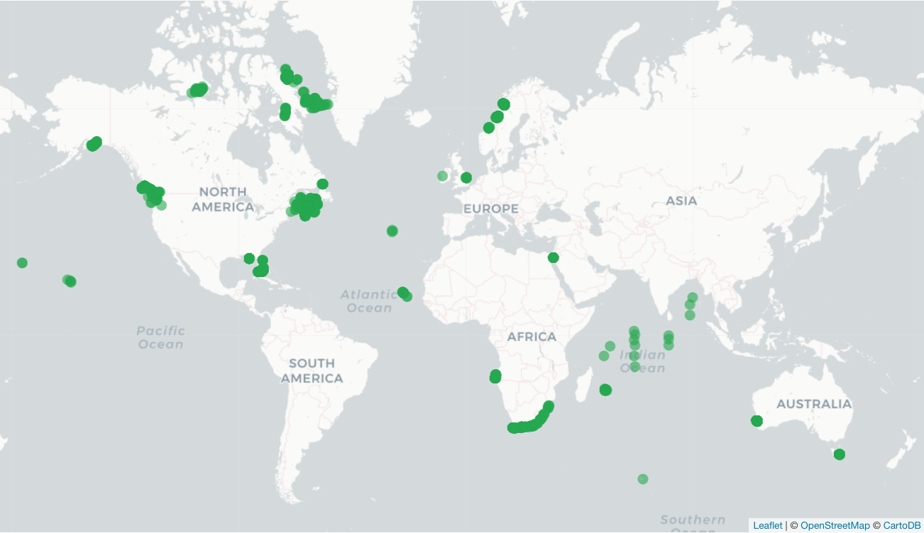
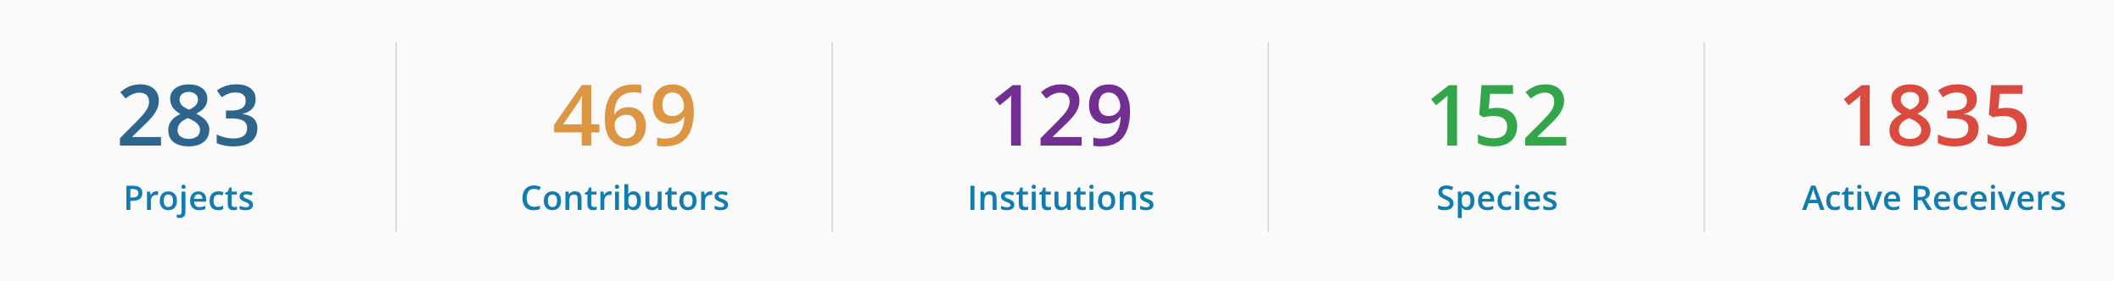
OTN around the world
c/o: https://members.oceantrack.org/statistics
Notes:
So here’s the current state of affairs for OTN and our reporting partners worldwide. We receive information from about 4000 listening stations every year, and have metadata for about 1800 actively-deployed listening stations by our Canadian partners and through international collaborations. Over 5000 animal tracking tags are currently active according to the latest records submitted by our collaborators, and new ones are being reported all the time. Funding for maintaining key OTN receiver arrays and data management personnel continues to be covered under the Canadian Foundation for Innovation Major Strategic Initiative grant until 2022. This 5 year grant is renewable and so we hope and anticipate being able to continue this work far into the future and allow our partners to leverage this base of infrastructure for global-scale scientific initiatives.

Slide 5
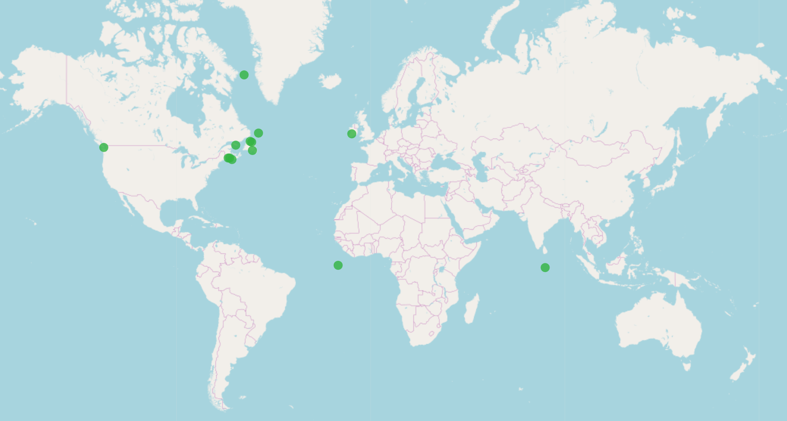
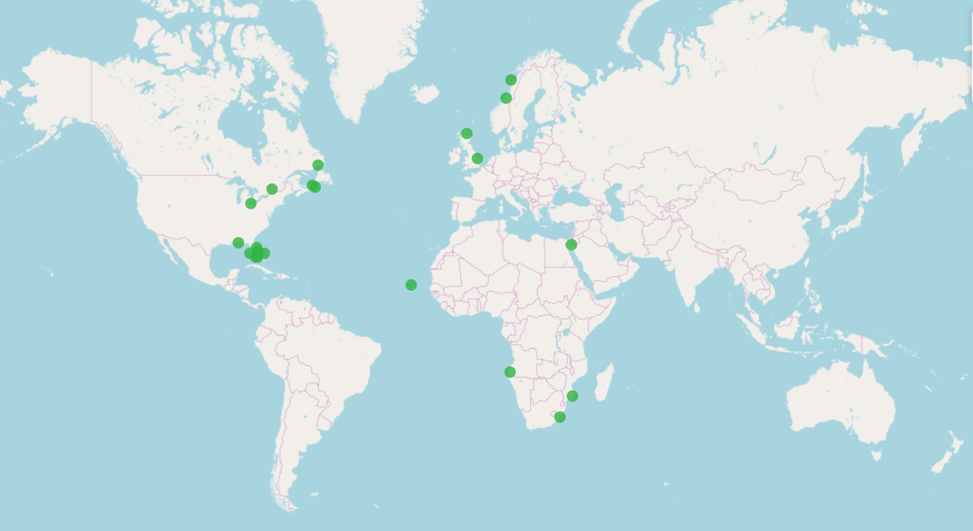
OTN around the world
Equipment loan program:
Hundreds of receivers loaned to
extend the capacity of projects and
telemetry networks worldwide
Buoys of Opportunity:
Partnerships between OTN and
existing mooring maintainers to
create new capacity inexpensively.
Currently 16 projects in the water worldwide, OTN partnering with:
Private Industry (oil and gas, energy, tidal power, aquaculture, marine engineering)
Scientific / Research organizations (DFO, Universities, NOAA)
Ocean Observing Networks (SmartBay Ireland, Ocean Networks Canada, US IOOS)
Federal and State governments (USA, India, Brazil, France)
OTN Buoys of Opportunity Program Partners
OTN Loan Program Recipients
Notes:
As we go on, so will our programs and initiatives. Two programs we’ve had a lot of success with are the ones we use to keep all our gear in the water, the equipment loan program and the buoy of opportunity program. Researchers have used our equipment loan program to extend the reach of their projects with surplus OTN equipment, taking on the used gear that has returned to the shelves in Halifax at the end of OTN Phase 1. This has had the result of introducing many new researchers from around the world to our network, bringing in their expertise in tracking new species, and opened us up to new methods in field work and analysis. [CLICK]
Similarly, our buoy of opportunity program lets OTN directly partner with organizations already deploying other sorts of moorings in a method that would be compatible with telemetry research, and adding our listening stations to their payloads. These partnerships are fairly benign for the mooring operators but lends new capacity to their observing systems and new collaborators in the local telemetry communities. Acoustic telemetry communities are especially prone to forming because of the intercompatibility of the listening gear, and wherever that seems to be reaching critical mass, we offer our database and our data ingestion pipeline to help manage their growing data needs. We call these sibling databases: Nodes.

Slide 6
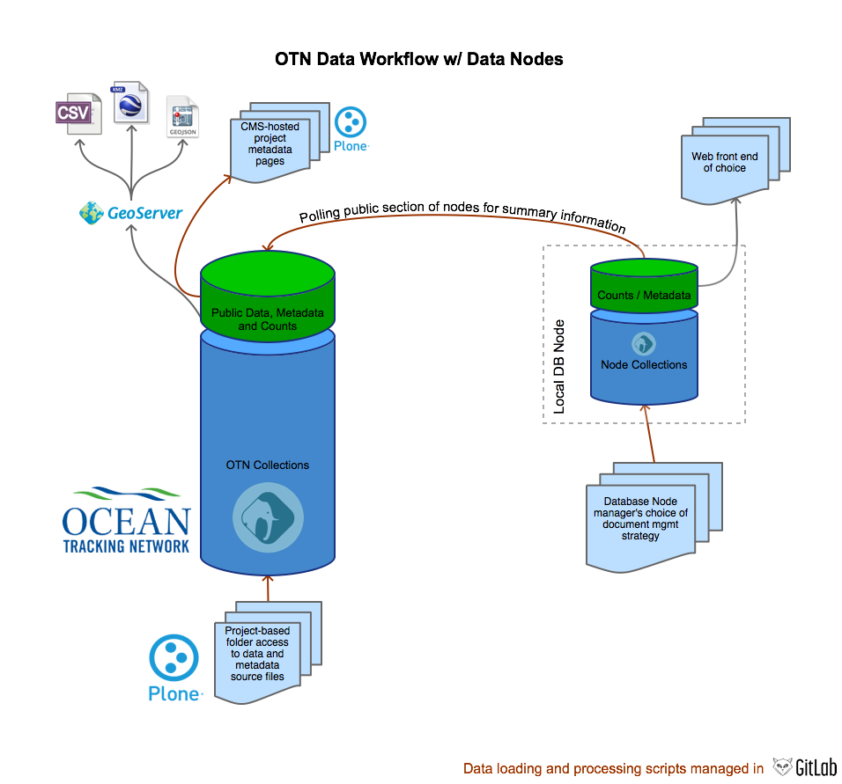
OTN database partners
SQL, scripts that build a Node DB
Shared processing scripts for managing data within nodes
Uniform public endpoints supporting exchange formats
Data products – standardized
Can report up to OBIS
Can cross-resolve tags and register in other OTN Nodes
Working w/ node special requests for data products
DB migrations via nomad
Notes:
So this is a nicely aged diagram of how we envisioned the Node databases would work. I have a much more complicated one of these that I won’t use here. So on this diagram, a Document Management System holds data and metadata files received from the researcher. Those feed into a database that is able to cross-reference other projects’ detection data for external tag detections, with a public-facing layer on top with a subset of the data that is currently fit for public consumption.
So for OTN, and for our NorthEast Pacific Node, and South Africa, and Brazil, and now FACT on the US Atlantic Coast, the whole structure’s very much the same as the left diagram, Plone for document management and for the public-facing web stuff and the researchers’ private repository folders, Geoserver and ERDDAP serve out data layers, using AAT in ERDDAP and a simpler, DarwinCore-named set of layers on the Geoserver. We launched a new data portal in 2017, and now our own GeoServer actually directly serves the interactive map features and supplemental information, a setup I’m really starting to recommend.
The point of the node paradigm is that instead of always following our lead, the other nodes are independent and free do some of these pieces differently if they want to. OTN-Brazil went with Plone for their portal software, just like we did, and they were able to drop in a version of what we do rather quickly because we also shared all our our webfront code and our Plone configuration. FACT, a group of sixty or so researchers who don’t really crave strong affiliation at this point, is getting their website together under the SECOORA and Axiom umbrella, and they do have ERDDAP and GeoServer standing by just like we do as data resources, but they don’t have to deploy them to publish everything the way we have. A little further north, a group called MATOS is in the Chesapeake doing their own thing completely, and are working towards plugging our data pipelines into a researcher-driven submission portal that will offer direct feedback to a submitter on potential flaws in their metadata and data files.
Also, when it comes to the public pieces of the database, nodes can use these to report out however they want to share their public data with partners. We can use a lot of this information to connect nodes with databases that aren’t formatted like ours, but there is a bit of work to do to find that common ground, work we did with ETN last year when Benny and Filip came to Halifax from VLIZ to help us build a mechanism to map mystery tags between our groups. It’s our hope, and OTN will continue to work towards seeing, that anything we do will come back into this node software ecosystem and thus be of benefit to everyone.
When OTN writes extensions to the structure of our database, we create a SQL migration, using a simple migration package that Kyle actually put us onto a few years ago, called nomad. Our philosophy there is not to do anything destructive, we want every one of our nodes to be able to come along without worrying about breaking something they’ve built. We’ve published a few database migrations over the past year that have mainly simplified and sped up the population of some of our discovery metadata tables, and we’re about to release a migration that will enhance how we track the researchers affiliated with our projects, giving them a temporal dimension as well as leveraging the ORCID researcher database to track them authoritatively. We also have in there a tool that lets us cross-reference our held species information against the IUCN RedList for reporting purposes.

Slide 7
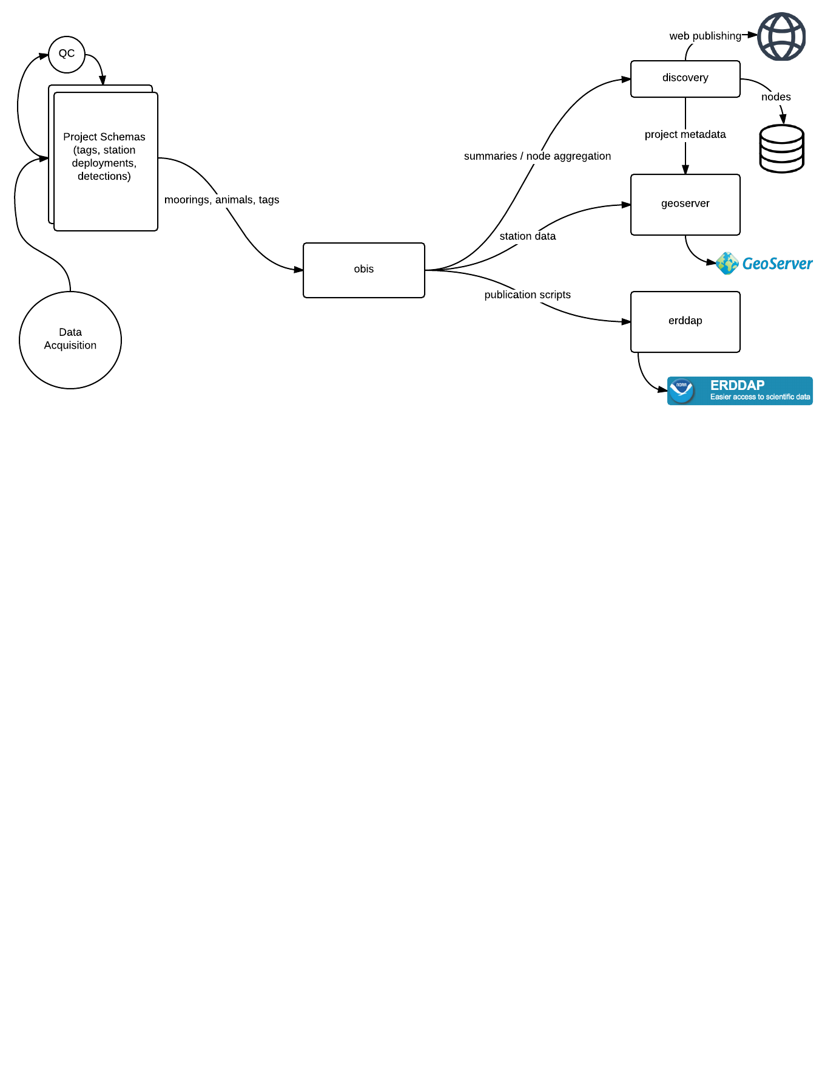
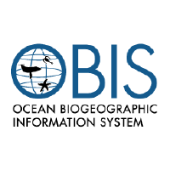
how the data moves
Parent Schema
ATN DAC
All arrows == GitLab-shared Python/SQL scripts
Notes:
So that last slide was for between-node and out-of-node things. We can look at how data gets into a single node as well.
So let’s say the whole process of data acquisition is that big uncomplicated circle there. Everyone in this room can appreciate how difficult that process actually is, and we’ve got fully half of our QC scripting ( not to mention our staff ) dedicated to catching problems at this level. Once we’re happy with the submissions, our researcher-provided data gets loaded into their individual project schemas, which can be one per study or maybe we combine a few studies belonging to the same person, though we have found that separating projects by study question is easier and more sensible for citation and preservation purposes. All that study data gets QCed further with respect to what else is already in the database, and then gets reformatted and promoted within the project schema until the data can be inherited by the aggregate schema.
The aggregated parent schema is the united dataset that we use to:
generate summaries and data products for the web
push subsets of public data to Geoserver and ERDDAP,
build privately held detection extract files that give a researcher a complete summary of everywhere their animals have been detected
Because each project, and each node, are set up the same way, we can use a single set of rules and processes to publish a project’s data from any of the OTN-like databases to its Geoserver, to its ERDDAP and where applicable, to upstream national aggregators like the ATN DAC and OBIS. This inheritance aggregation also lets these self-contained project schemas that live in one OTN database node to cross over wholesale into another database node, thus sharing its information with multiple databases at once. A parent node identifier is assigned to projects that leave their parent node, which allows us to determine which node is authoritative for writing data to that project and helps avoid namespace issues, and all databases that receive this node information can resolve detections and project metadata for the projects that are mirrored in this way. This reduces reporting requirements for investigators that are members of multiple organizations and broadens the reach of their projects as they can join other database nodes and match their tagged animals with minimal extra effort on their part.
Every piece of this process is defined and executed as part of a Python library published by OTN and shared with all of our Node operators, acting on a database whose structure and operation are defined in a sister project that allows a user to spin up an OTN Database Node as a standalone server, as a virtual machine, or on cloud services as a Docker constellation. We again have Axiom to thank for introducing us to Docker and contributing that piece of work.

Slide 8
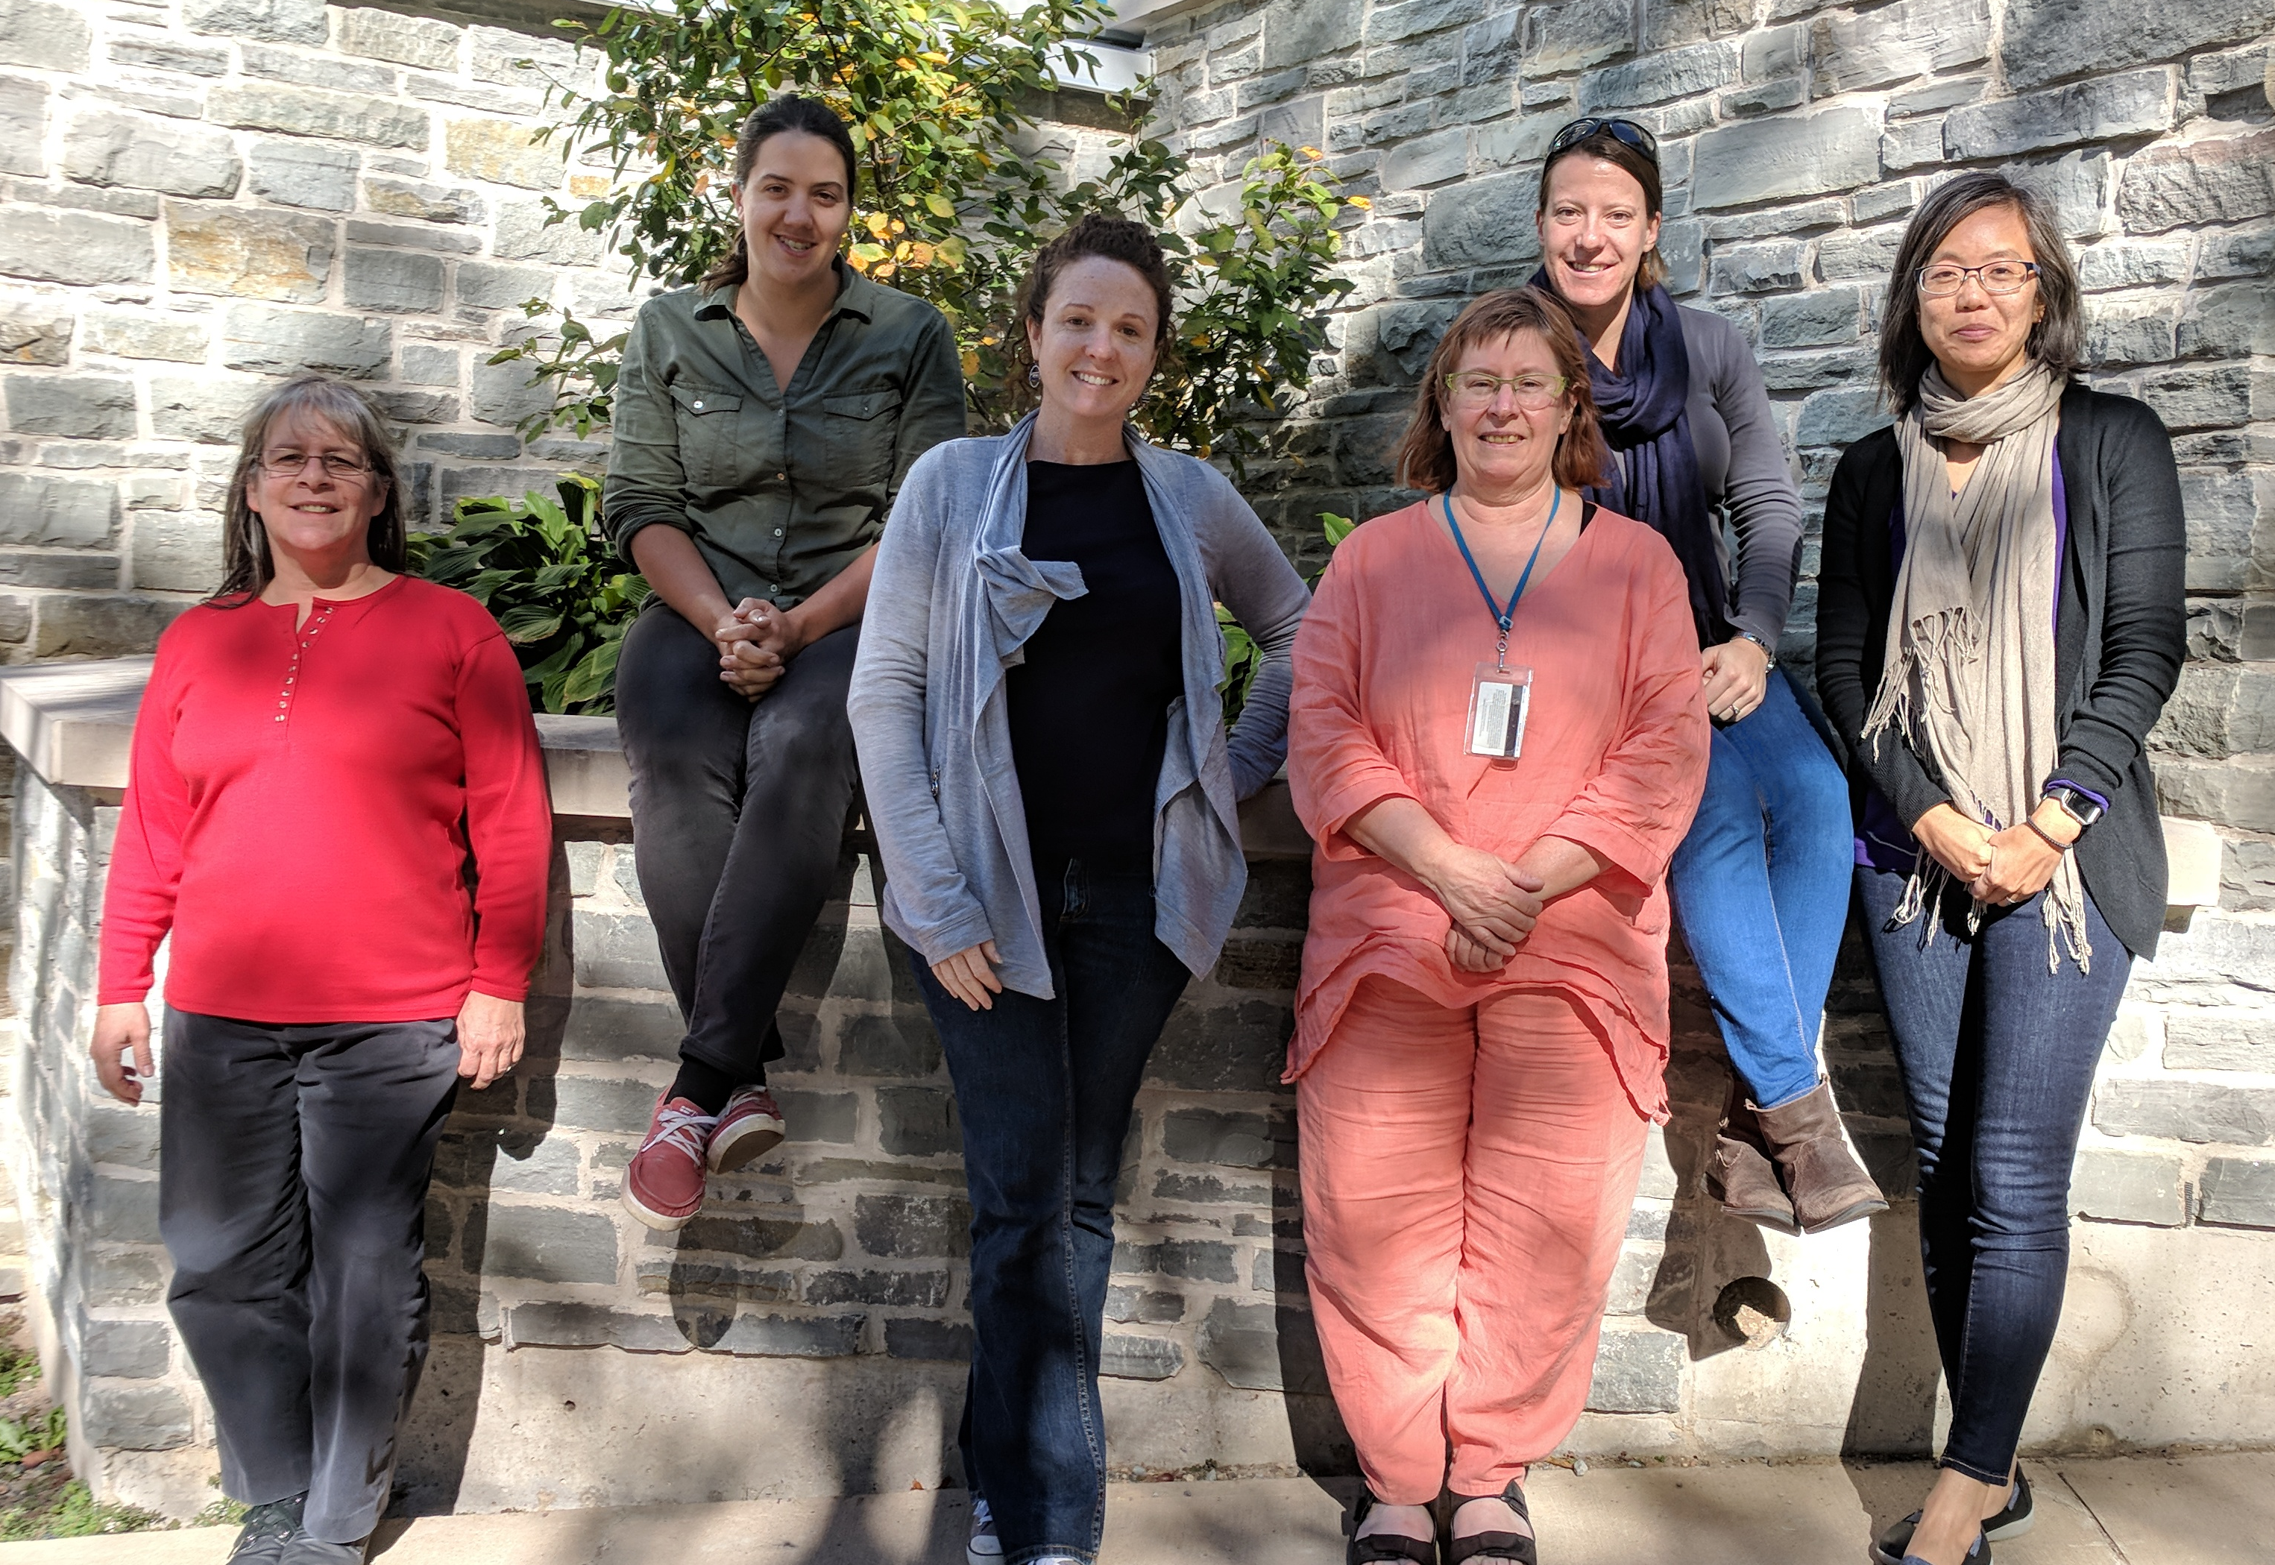
who we bring together
Third iteration of the OTN Data
Management Workshop
was held in Halifax mid-2017
Data Managers attended from:
FACT
DFO Ottawa
SAIAB – OTN South Africa Node
Current cross-compatible databases:
OTN Global (Arctic + N. Atl. + Med)
OTN Pacific (Pacific)
OTN South Africa
OTN Brazil (S. Atl.)
FACT (N. Atlantic)
USCAN (Caribbean)
MATOS (N. Atlantic)
Committed Data Partners:
European Telemetry Network
IMOS-AT (Australia)
GLATOS (Great Lakes)
Notes:
To keep our node operators up to date on the developments, and to harvest suggestions from them on what to build next, we get together whenever we can for node training workshops. Recently, we held a Data Management Workshop up in Halifax just after our annual Symposium, which a lot of you attended, and there we were able to pull together Joy Young from FACT, Dr. Taryn Murray who manages the database in South Africa, and Jenny Chiu from Canada’s Department of Fisheries and Oceans. We’re aiming to have another node training workshop in Winter 2018 on Florida’s Atlantic Coast, and we’re also in talks with groups in the Central Pacific region about combining their work into a potential OTN Node, and if that yields a positive result we’re looking at potentially putting on a workshop in November in Ecuador.

Slide 9
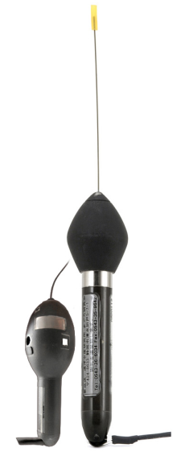
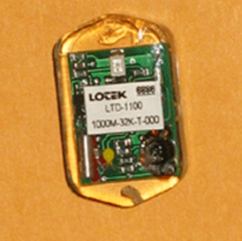
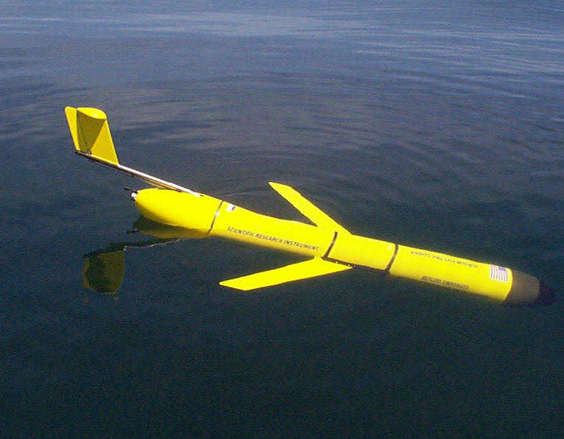
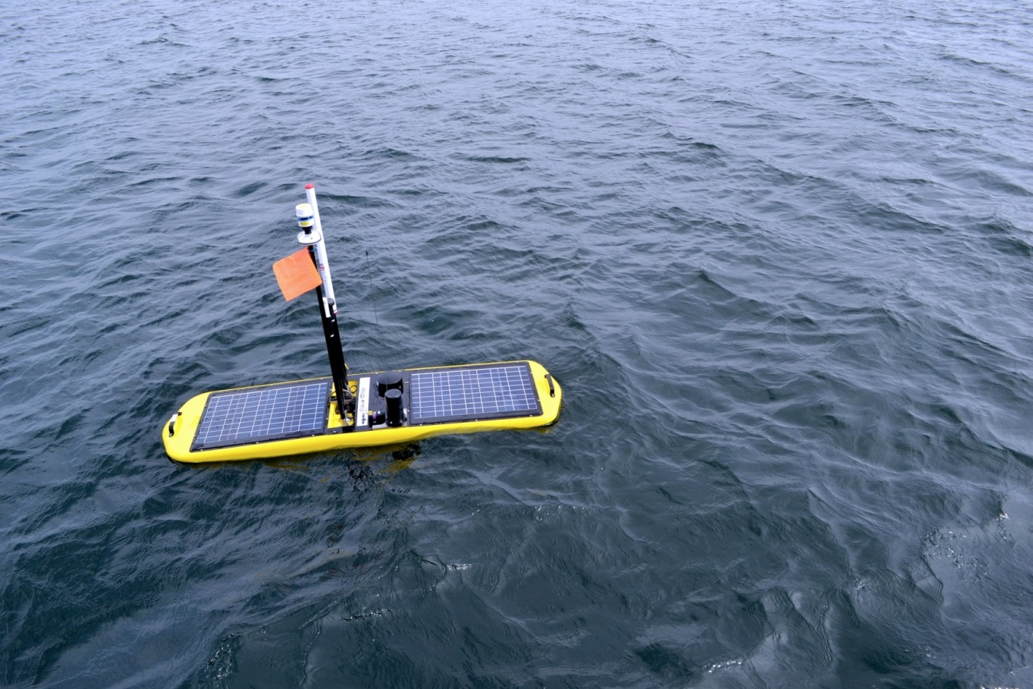
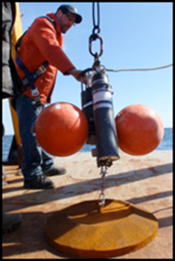
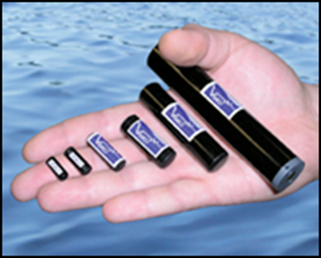
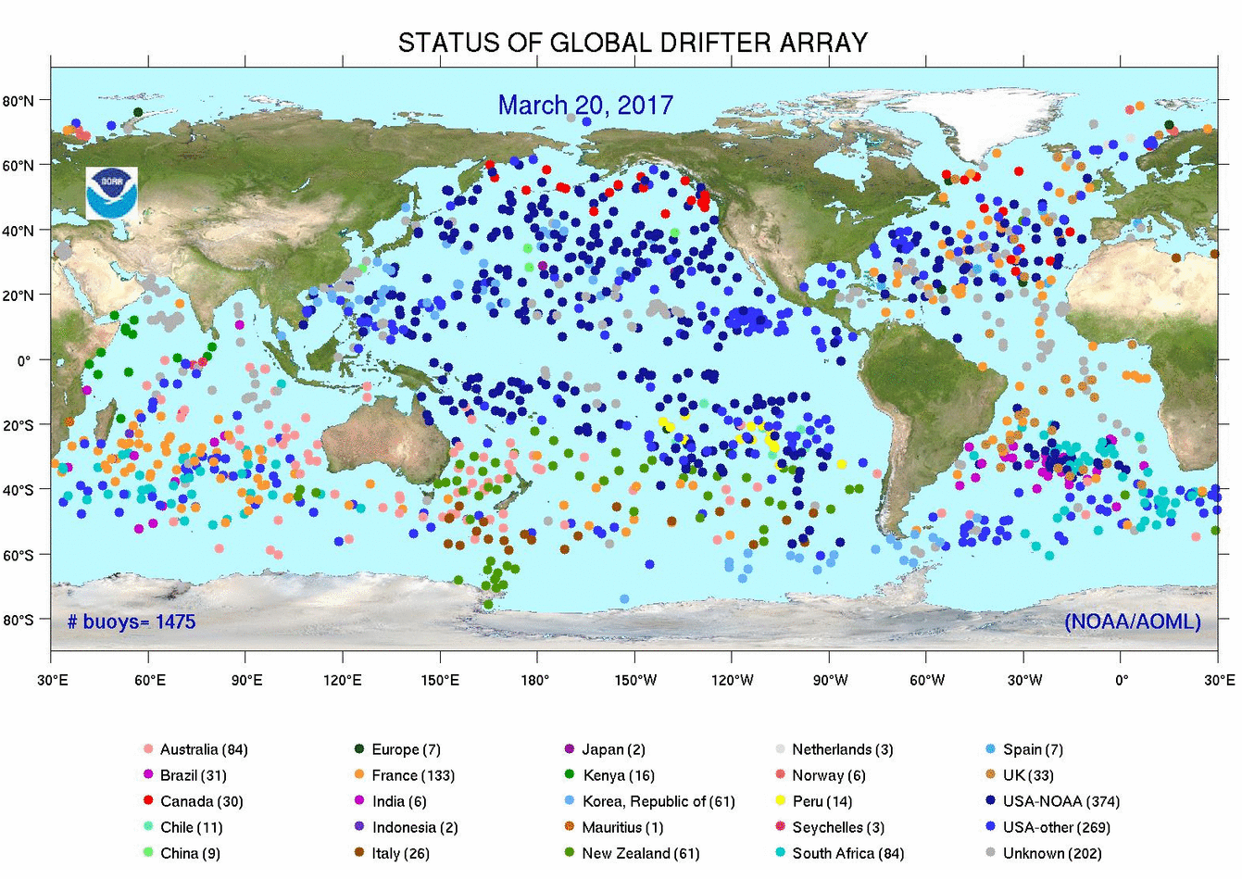
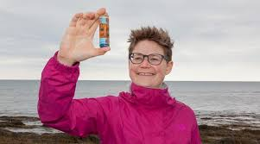
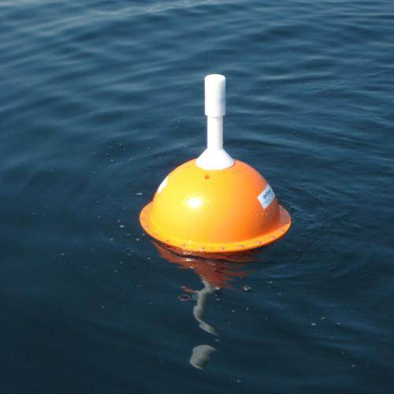
Sensor tags
what we report
Autonomous vehicles and ‘bioprobes’
New Technologies
Notes:
Over the last couple of months, we’ve been building out the pipeline to take OTN data and submit it to OBIS IPTs using Event Core / Occurrence Core / EMoF format. We’ve now got potential templates in need of a shakedown for simple acoustic telemetry projects and for projects using sensor-enabled acoustic tags, and we will take cues from the work done by ETN and IMOS for formatting and reporting satellite tag submissions. In looking forward to future headaches, I’m interested in examining scalability for the high-frequency oceanographic and physical data being reported by new instruments coming online now. Specifically we’ve got a large accelerometry dataset being generated by a tag that is gaining in popularity with our membership. We’ve also got a novel but not too different case in our autonomous vehicles and their mobile listening stations. I know we’ll all continue working together to wrangle this and other new technology into reasonable shapes as it starts showing up in our metadata sheets.

Slide 10
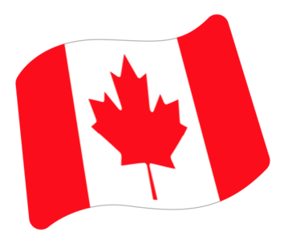

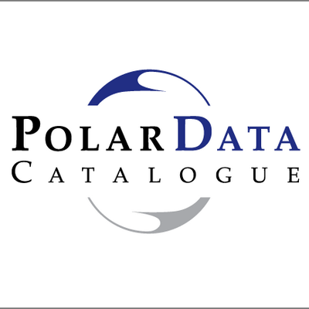
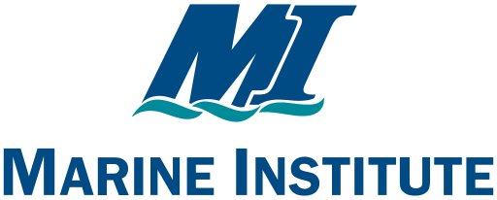
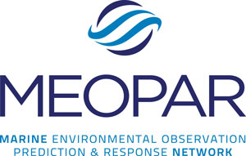
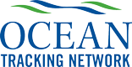
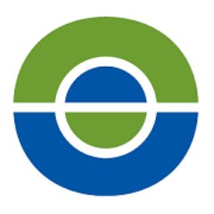
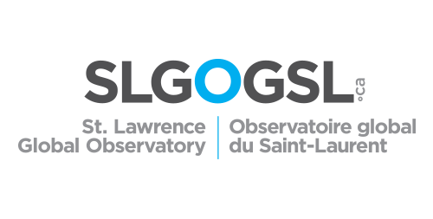
more OBIS-ENV
Canada’s Community of Practice for Ocean Data Management oceansdata.ca
Assembling a pan-Canadian team of CS students this summer for a capstone project
Project proposals from membership solicited last week.
Among the projects proposed, one by ONC + OTN:
Working together towards having more Canadian contributions with OBIS- ENV-DATA formats from our respective institutions (e.g., visual observations at sea or in video, sampled organisms, tagged animals, hydrophone classifications, etc.)
Notes:
One more thing I’d like to note, the Canadian Community of Practice for Ocean Data Management, of which OTN’s a member, is putting together a team of bright young CS students to deliver a capstone project, and we’ve been pitching ideas all month. One that got support both from us and from Ocean Networks Canada out in British Columbia, was the idea of bringing more datasets held among the membership into ENV-DATA formats. We’ve got a head-start on telemetry, obviously, but if this idea gets taken up we might see some more OBIS-ENV reporting activity from all Canadian ocean data providers.

